Slide 1

Customer Segmentation
Submitted by:- Submitted to:-
Arpit shrivastav Mr. Sanjay Madan
Sumit Thakur
Rahul Thakur

Slide 2
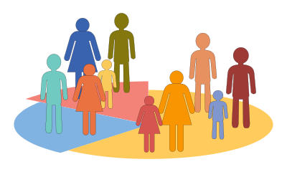
What is Customer segmentation?
Customer Segmentation is the process of division of customer base into several groups of individuals that share a similarity in different ways that are relevant to marketing such as gender, age, interests, and miscellaneous spending habits.

Slide 3
Dataset Description:
We have taken this data from Git hub
It has individual unique customer IDs, a categorical variable in the form of Gender and three columns of Age, Annual Income and Spending Score .

Slide 4
OBJECTIVE
The objective of the project are as follows:
Identify the potential customer base for selling the product.
Implement Clustering Algorithms to group the customer base.

Slide 5
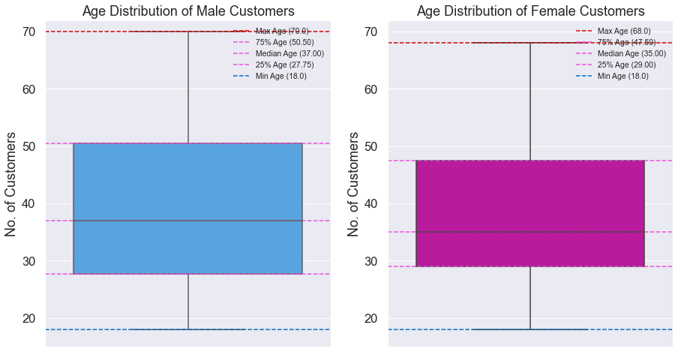
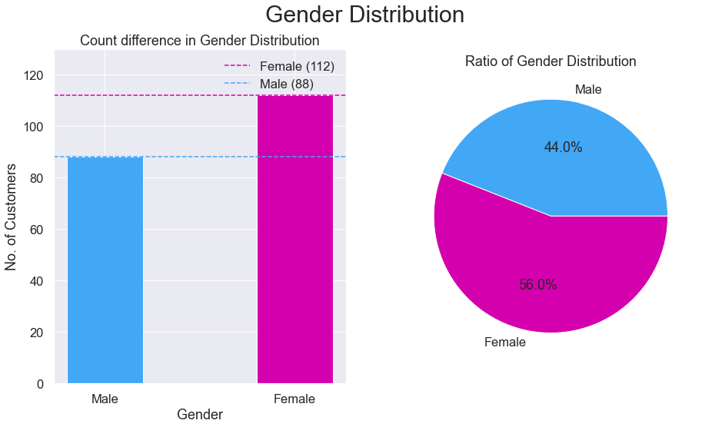
EXPLORATORY DATA ANALYSIS
Visualization of Distribution of Males and Females:

Slide 6
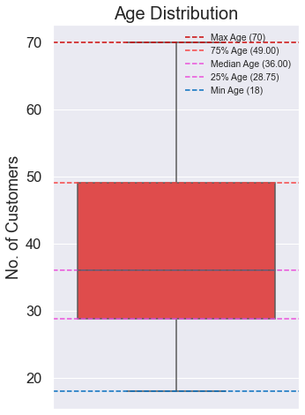
AGE ANALYSIS OF CUSTOMERS
From the above boxplot, we can conclude that a large amount of ages are between 30 and 35. Min Age is 18, Max Age is 70. By comparing the age distribution of the customers, we can conclude that most of the customers were within the band between 30 to 50, where the mean is around 35 years old.

Slide 7
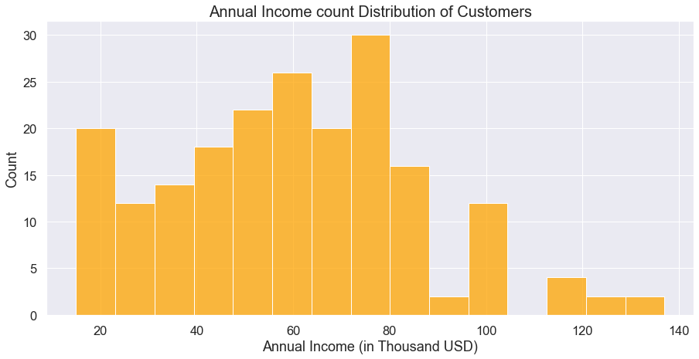
Anual Income and Spending Score Analysis:
The distribution of Anual Income and Spending Score exhibited an approximation of normal distribution, with highest density around the mean of the variables. The maximum and minimum of Annual Income are 137 and 15 respectively, with the mean at 60.56. From the plot, we can see that the peak of the distribution fell in the region of 60 to 75.

Slide 8
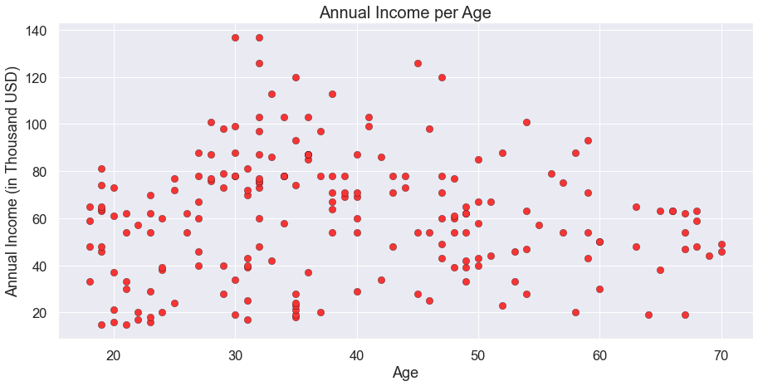
CHARACTERISTIC RELATIONS
Annual Income vs Age analysis:

Slide 9
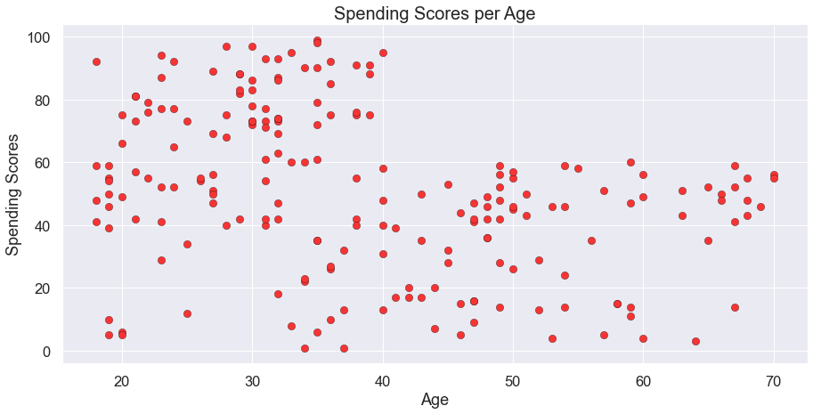
SPENDING SCORE VS AGE ANALYSIS

Slide 10
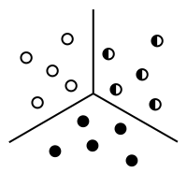
WHAT IS CLUSTERING ?
The process of segregating objects into groups based on their respective characteristics is called clustering. In clusters, the features of objects in a group are similar to other objects present in the same group.
K-Means Clustering
K-means clustering is a simple unsupervised learning algorithm that is used to solve clustering problems. It follows a simple procedure of classifying a given data set into a number of clusters, defined by the letter "k," which is fixed beforehand. The clusters are then positioned as points and all observations or data points are associated with the nearest cluster, computed, adjusted and then the process starts over using the new adjustments until a desired result is reached.

Slide 11
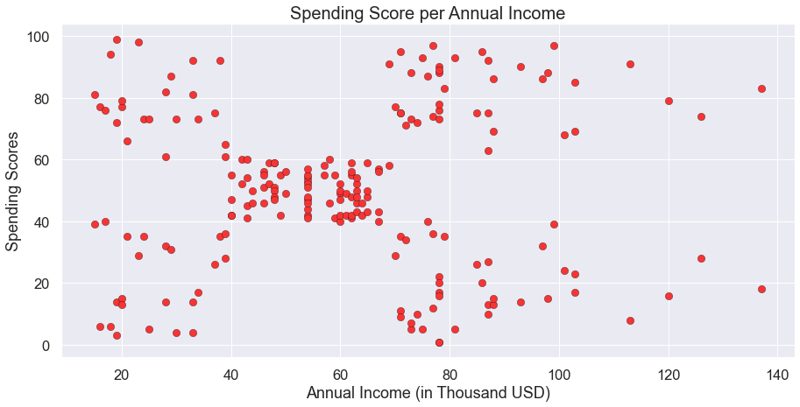
Building the k-means model
We need to visualize the data which we are going to use for the clustering. This will give us a fair idea about the data we're working on. This will give us a fair Idea and patterns about some of the data.

Slide 12

The elbow method
The Elbow method runs k-means clustering on the dataset for a range of values for k (say from 1-10) and then for each value of k computes an average score for all clusters. By default, the distortion score is computed, the sum of square distances from each point to its assigned center.
We use the Elbow Method which uses Within Cluster Sum Of Squares (WCSS) against the number of clusters (K Value) to figure out the optimal number of clusters value. WCSS measures sum of distances of observations from their cluster centroids which is given by the below formula.
where Yi is centroid for observation Xi. The main goal is to maximize number of clusters and in limiting case each data point becomes its own cluster centroid.

Slide 13
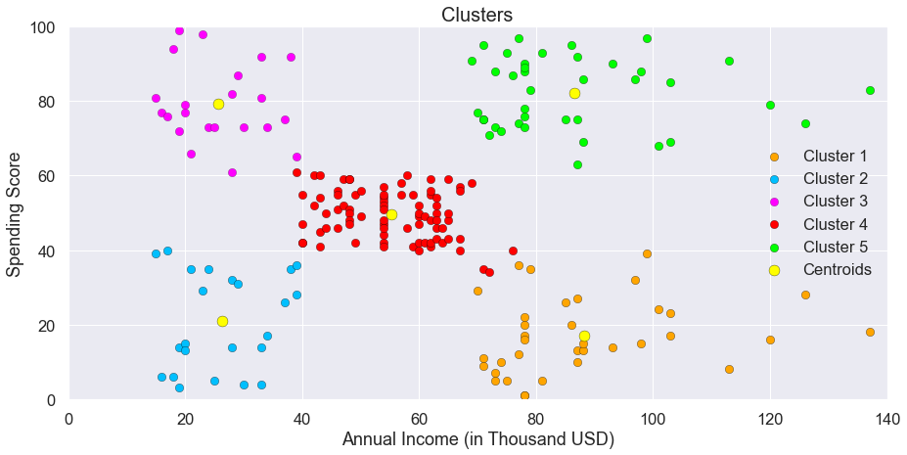
Cluster analysis :
The following clusters are created by the model,
Cluster Orange
Cluster Blue
Cluster Purple
Cluster Red
Cluster Green

Slide 14
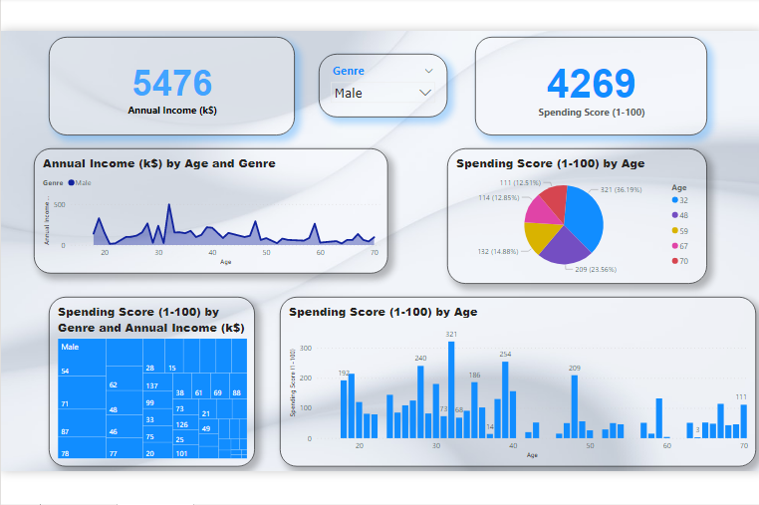
Dashboard of Customer Segmentation Male Customers

Slide 15
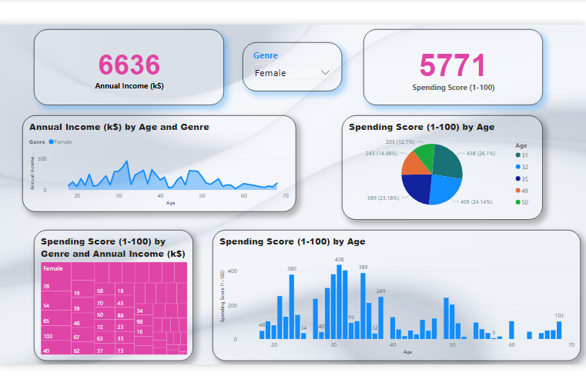
Dashboard of Customer Segmentation Female Customers

Slide 16
Thank You

